Slide 1
ODK: From App-Designer to Tablet
Dr. Caroline Krafft
St. Catherine University
cgkrafft@stkate.edu
Version: January 14, 2018

Slide 2
Moving from Survey to Tablet
2
Design survey in Excel (for now can use examples that come with app designer)
Convert Excel with App Designer and XLSXconverter
Can check out test versions in preview
Now you want to “push” your survey on to tablets
Have to do this BEFORE pushing to ODK Aggregate Server
Done by the administrator, then other tablets can sync from server
“Push” with command window and Android SDK tools

Slide 3
Tech for Pushing Survey
3

Slide 4
Android Debug Bridge
4
Android Debug Bridge (adb) is a command that allows you to communicate with a device that is connected via USB.
To check if adb is installed so it runs from your app designer, navigate in the command window to app-designer and type the following command
adb version
Should display the installed version of adb;if not continue to the next slide

Slide 5
Changing adb Path
5
If you installed Nodejs on your computer correctly adb should be saved on your computer somewhere, it might just be hidden.
In your command window go to the directory C:\Users\[you]\AppData\Local\Android\sdk\platform-tools
Now try the command
adb version
The installed version of adb should now display.
If this is where adb is located on your computer, the path needs to be changed so adb can be accessed by your user

Slide 6
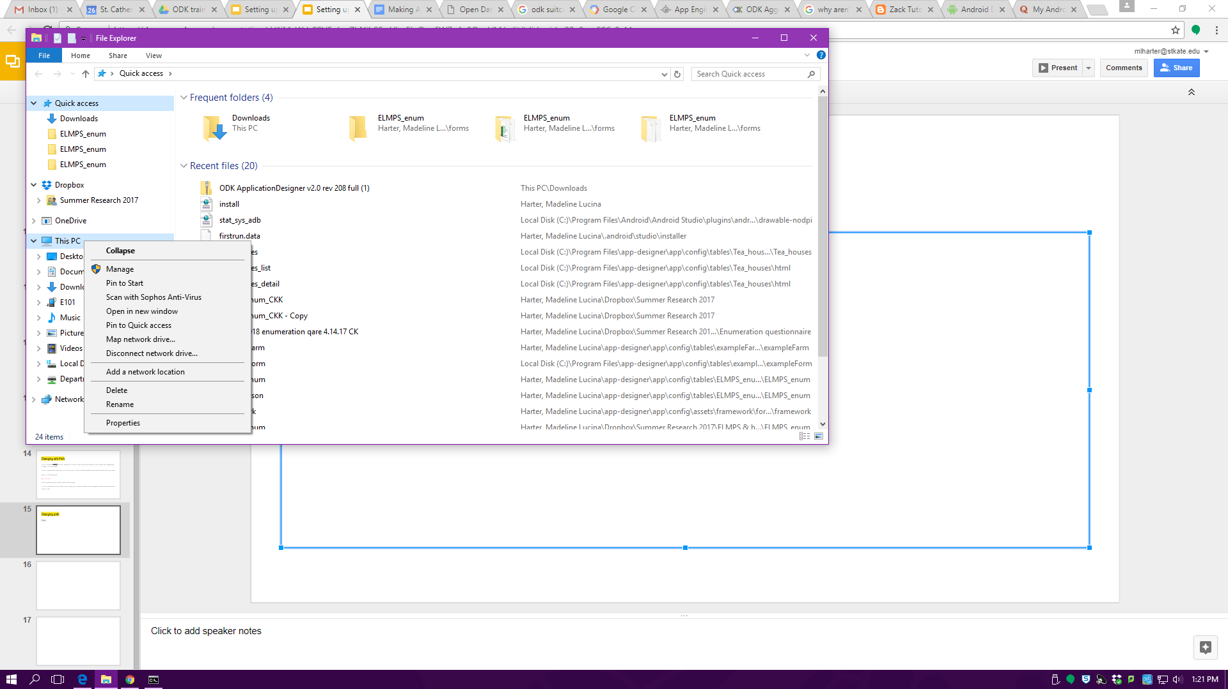
Changing path
6
First go to files and right click on This PC and choose Properties

Slide 7
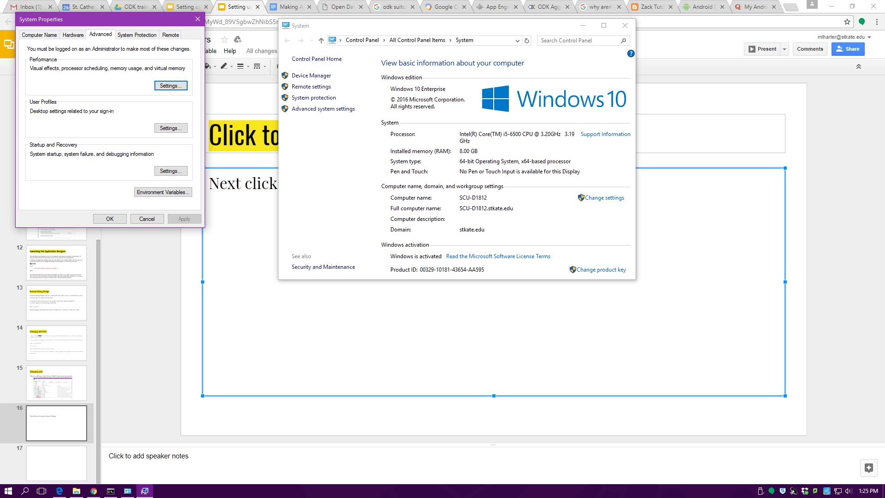
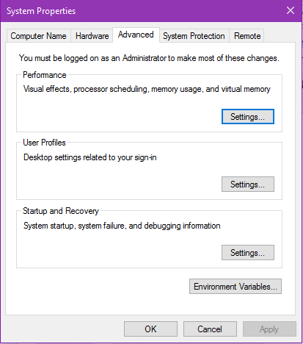
Changing path
7
Next click on Advanced System Settings
Then, click on Environmental Variables

Slide 8
Changing path
8
Once here, you will need to create two new user variable and edit the path variable that already exists.
Create ANDROID_PLATFORM_TOOLS with the value being the place your adb is located (in my case C:\Users\[username]\AppData\Local\Android\sdk\platform-tools)
Create ANDROID_TOOLS with the value C:\Users\[username]\AppData\Local\Android\sdk\tools (customized to your users)
Create GRUNT with the value C:\Users\[username]\AppData\Roaming\npm (customized to your users)
Change the path variable so the value looks like this %Path%;%ANDROID_PLATFORM_TOOLS%;%ANDROID_TOOLS%;%GRUNT%
**Images on next page

Slide 9
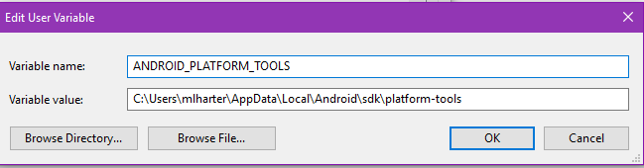
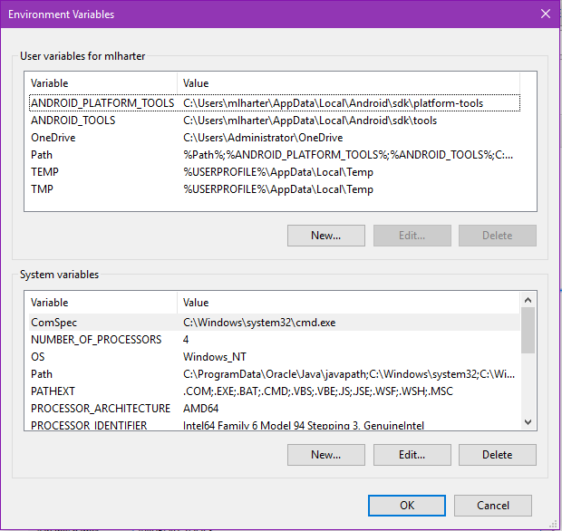
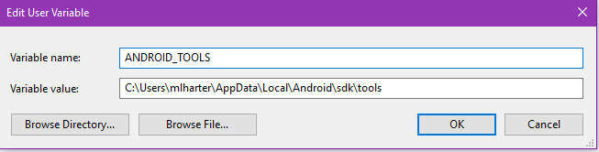
Changing path
9
1.
2.
3. Final product

Slide 10
Changing path
10
Now in the command window, try the command:
adb --version
It should now show the adb version
If not restart your computer and try again

Slide 11
Pushing Survey to Tablet
11

Slide 12
Prepping for Survey
12
Before pushing your survey onto your tablet you need to force close all of you ODK 2.0 apps including OI File Manager.
To do this:
Go to settings and click on apps
Click on each of the ODK 2.0 apps and click force close
CLOSE ODK SERVICES LAST-- if not it will not close because the other apps are still open
In OI File Manager delete the folder default (if present) in sdcard/opendatakit

Slide 13
Pushing Survey
13
Once your device is setup correctly and all of the apps are closed, plug in your device with a USB cord.
Next, go to the command window on your computer and make sure your directory is ..\app-designer
The following command
grunt adbpush-default-app
will push your survey onto your tablet -- you will know it was successful if, after a few seconds of thinking, the command window will say
Done, without errors.

Slide 14
Things that can cause problems
14
Your app-designer should only have necessary working files.
If you are holding onto any older versions of your survey, make sure they are saved outside of your app-designer directory.
Do not have any Excel forms open on your computer
This will cause errors with $filename or ~$filename in the filepath when pushing
Double check Android SDK has all the USB and SDK pieces checked
Check that your computer sees the tablet
Enter adb devices in command line
Should show a device detected
Add Android USB manager on the tablet -- Google Play store
Need to authorize device (check tablet to see if it has a message about authorizing the computer)

Slide 15
Initializing Tables & Survey
15
Open ODK Tables
Should get messages about configuring and (hopefully) initialization completed successfully
Open ODK Survey
Should get messages about configuring and (hopefully) initialization completed successfully
Your survey should appear and you will be able to start to complete instances
If you look in OI file manager under sdcard/opendatakit/default your app-designer files should be there

